Slide 1
FS disk structure
Free block list
Boot block
Super block
Inode table
Root dir 1st block

Slide 2
Path = /home/user1/story1.txt
Yêu cầu: (1) Sử dụng FSshell tạo thư mục trên;
(2) Quan sát móc nối inode và điền vào bảng dưới đây.
Path = /
Path = /home
Path = /home/user1
Path = /home/user1/story1.txt
Inode =0
Md | 1
LC | 2
Sz | 400
Di | 3
SI | Null
Inode = 1
Md | 1
LC | 3
Sz | 72
Di | 4
SI | Null
Inode =2
Md | 1
LC | 3
Sz | 72
Di | 5
SI | Null
Inode =3
Md | 0
LC | 1
Sz | 1151
Di | 6
SI | 8
Data block: 6
File block 1
Data block:
 | 0
home | 7
story2.txt | 4
hardlink | 4
symlink | 5
Data block:
. | 1
.. | 0
user1 | 2
Data block:
. | 2
.. | 1
story1 | 3
Data block:
7
9
10
11
Chú thích: md (mode), lc (linkcount), sz (size),
di (direct pointer), si (single indirect pointer).
Data block:7
File block 2
Data block:9
File block 3
Data block:10
File block 4
Data block:11
File block 5

Slide 3



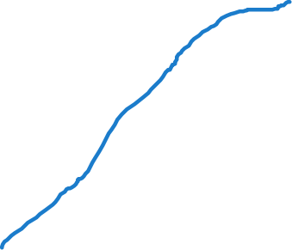
Hard and Symbolic links
Path = /
Path = /hardlink
Path = /symlink
Inode =0
Md | 1
LC | 6
Sz | 144
Di | 3
SI | NUll
Inode = 4
Md | 0
LC | 2
Sz | 1183
Di | 12
SI | 14
Inode = 5
Md | 2
LC | 1
Sz | 10
Di | 18
SI | Null
Data block: 3
. | 0
.. | 0
home | 1
story2.txt | 4
hardlink | 4
Data block: 12
1st block of story2.txt
Data block: 18
story2.txt

